Slide 1
Historic
Pictures of Dares worldwide:

Slide 2
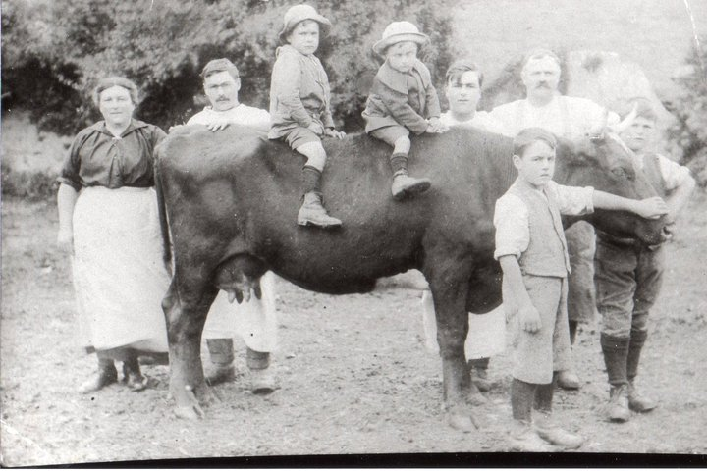
Dares in Australia
The Dare Family - Ada Bright - Mark, Cecil, Jim, Frank, Frank Sr, & Percy Dare, Stanley Dare in front

Slide 3
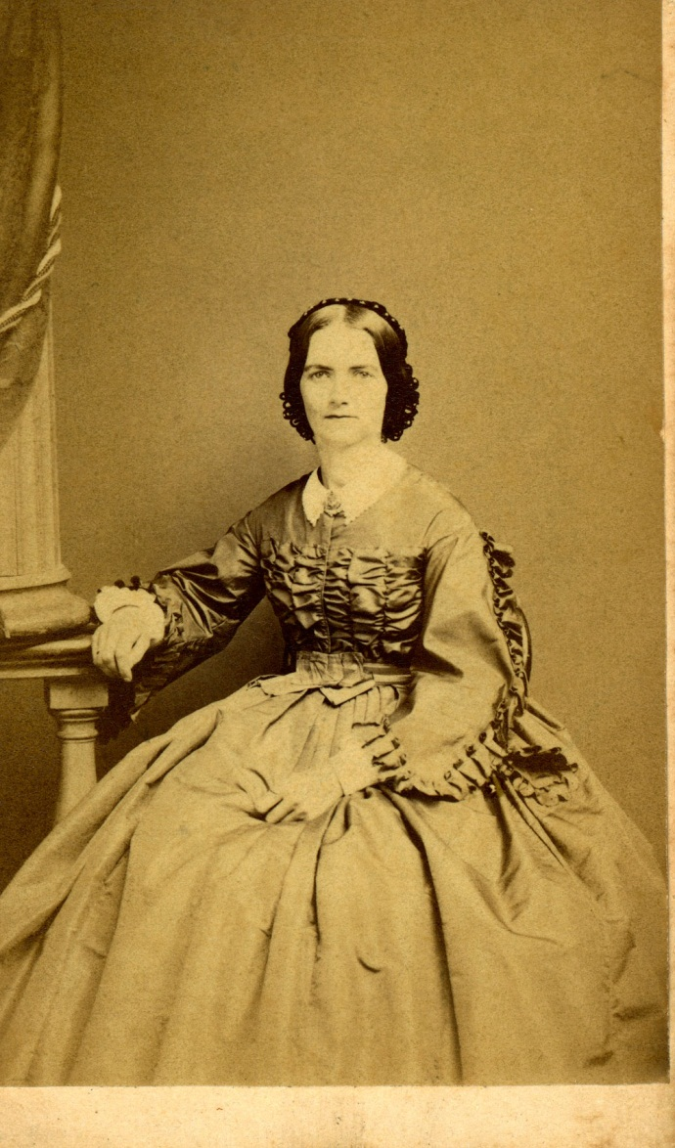
Descendants of Captain William Dare of Lyme Regis and NJ:
Caroline Harris 1830 wife of George Gandy 1828 taken in 1865

Slide 4
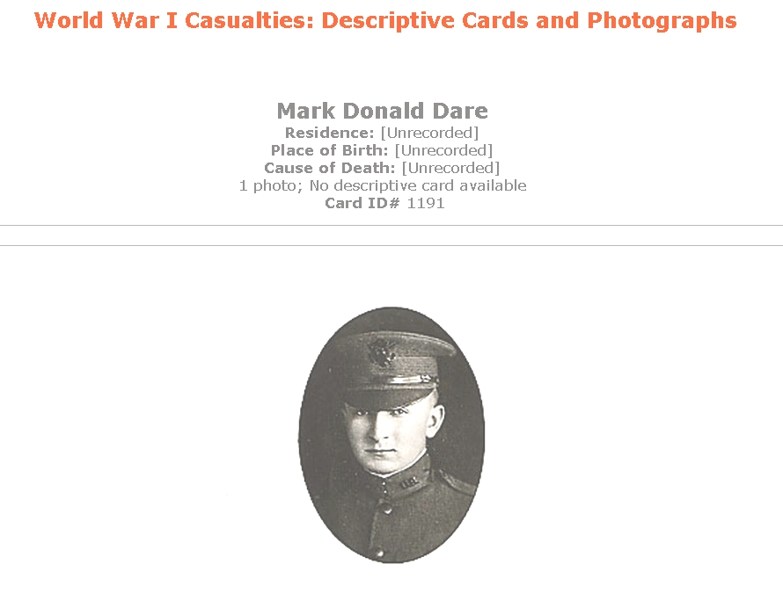
Mark Donald Dare - KIA 1917 WW 1

Slide 5
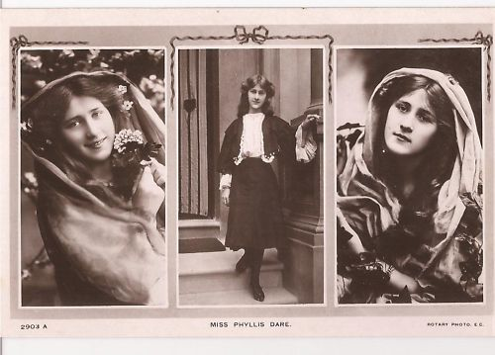
Phyllis Dare, actress in England 1910

Slide 6
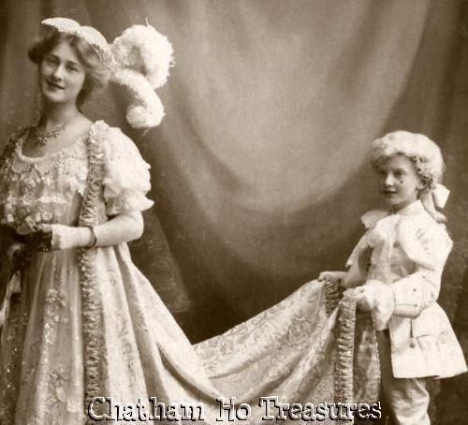
Phyllis Dare, actress in England 1910

Slide 7
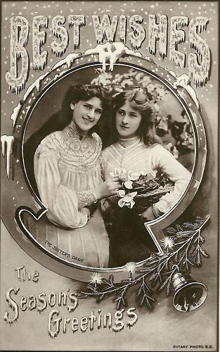
Phyllis and Zena Dare - postcard 1905

Slide 8
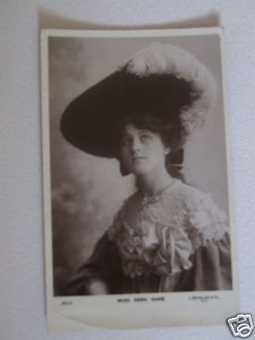
Zena Dare - postcard 1905

Slide 9
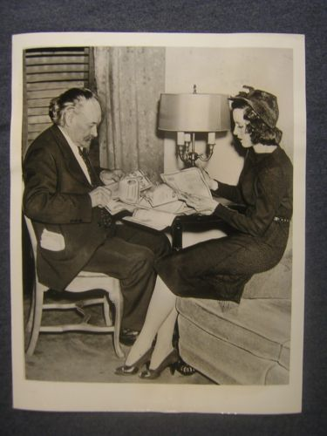
Hope Dare actress - 1930s

Slide 10
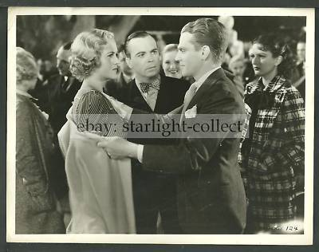
Dorothy Dare and James Cagney – Hollywood

Slide 11
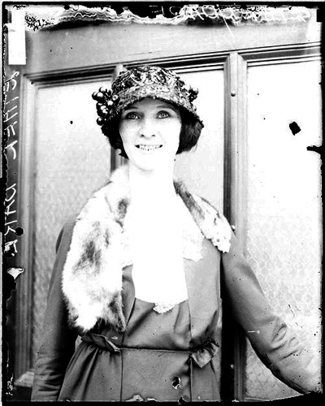
Aviatrix (Pilot) Ethel Dare

Slide 12
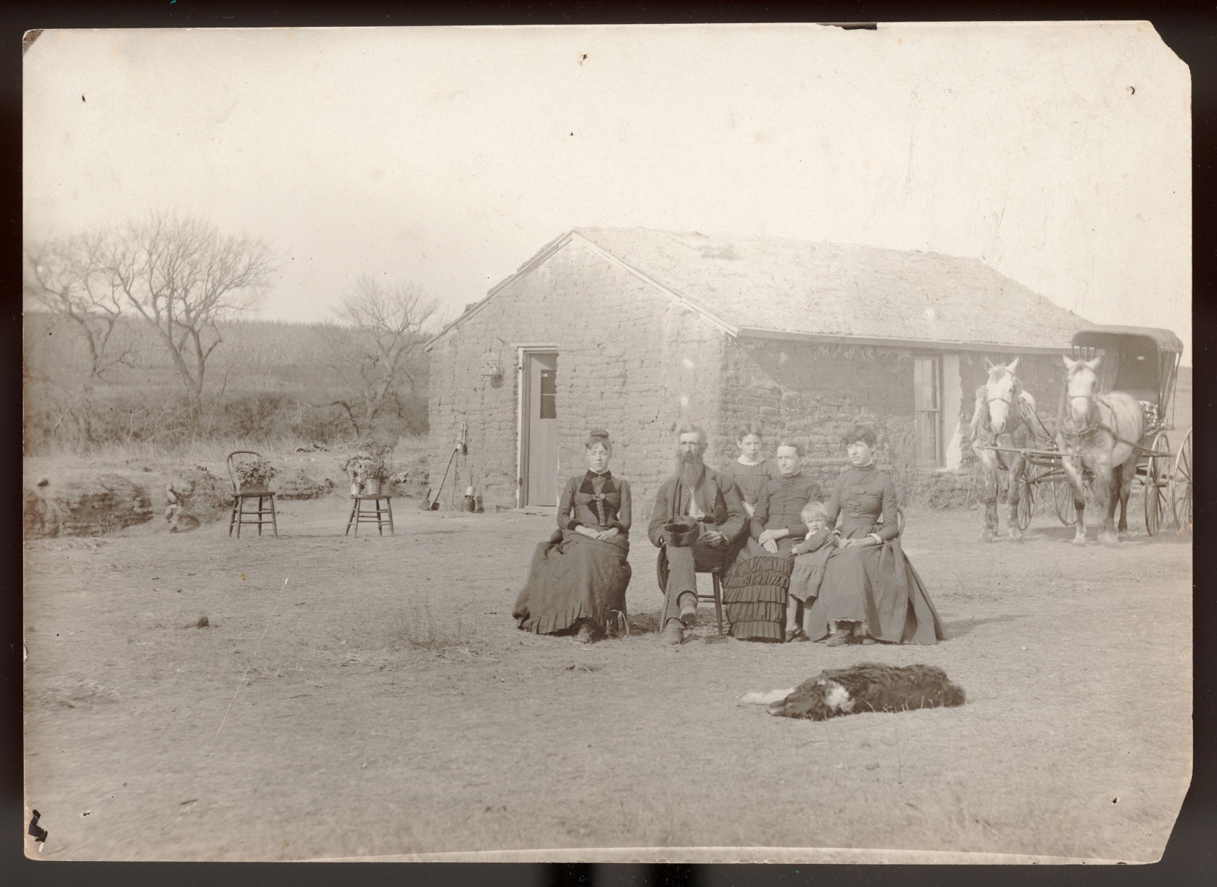
James Dare in front of his homestead
in Custer Co, NE - circa 1888

Slide 13
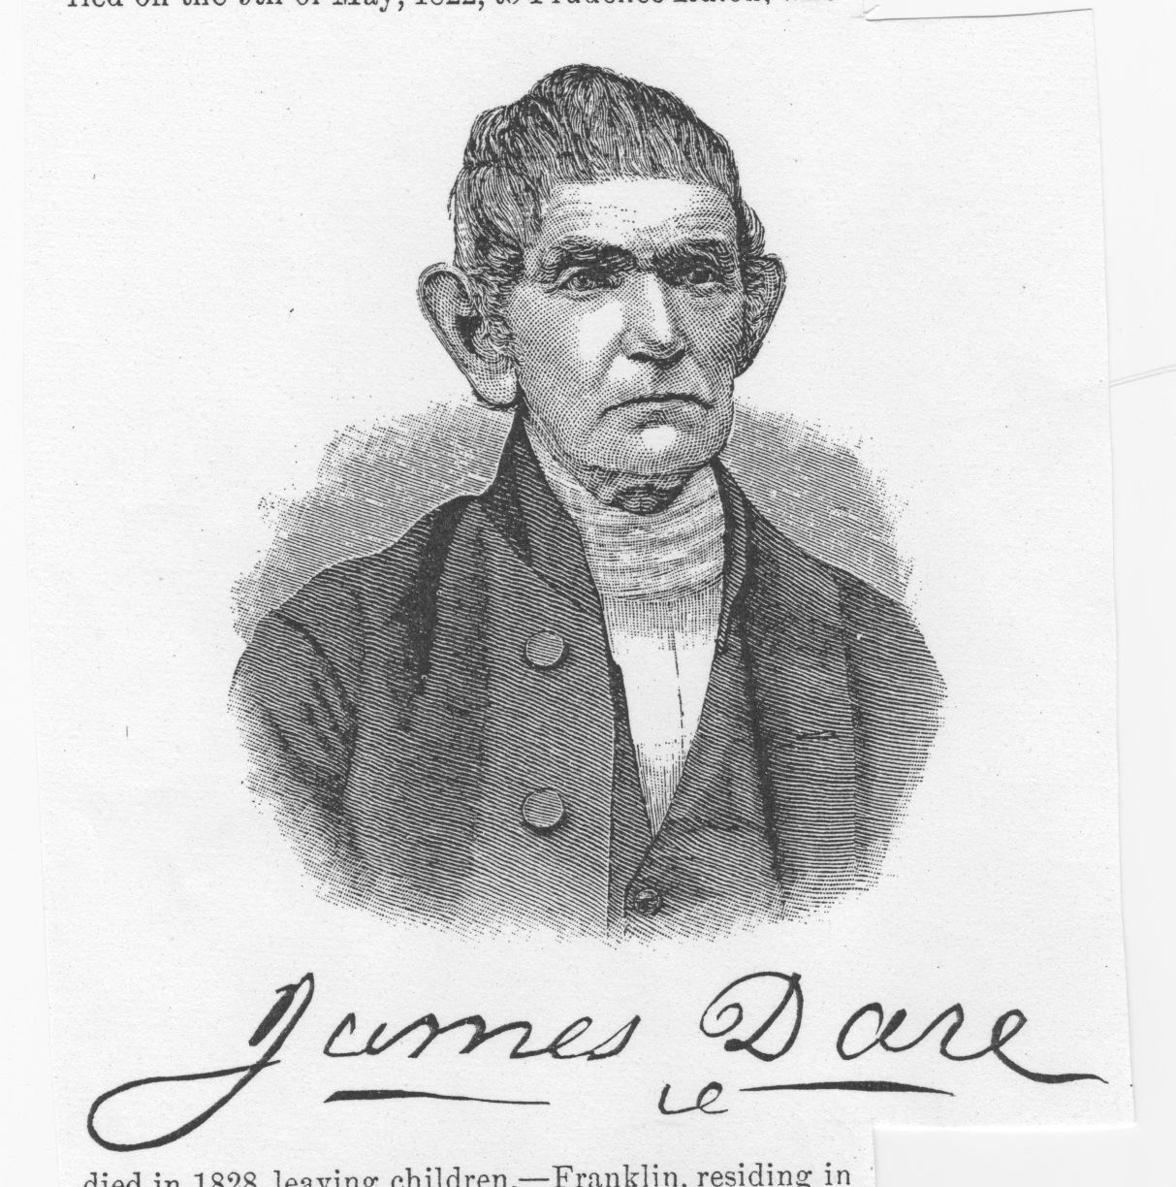
Drawing of James Dare - b 1803

Slide 14
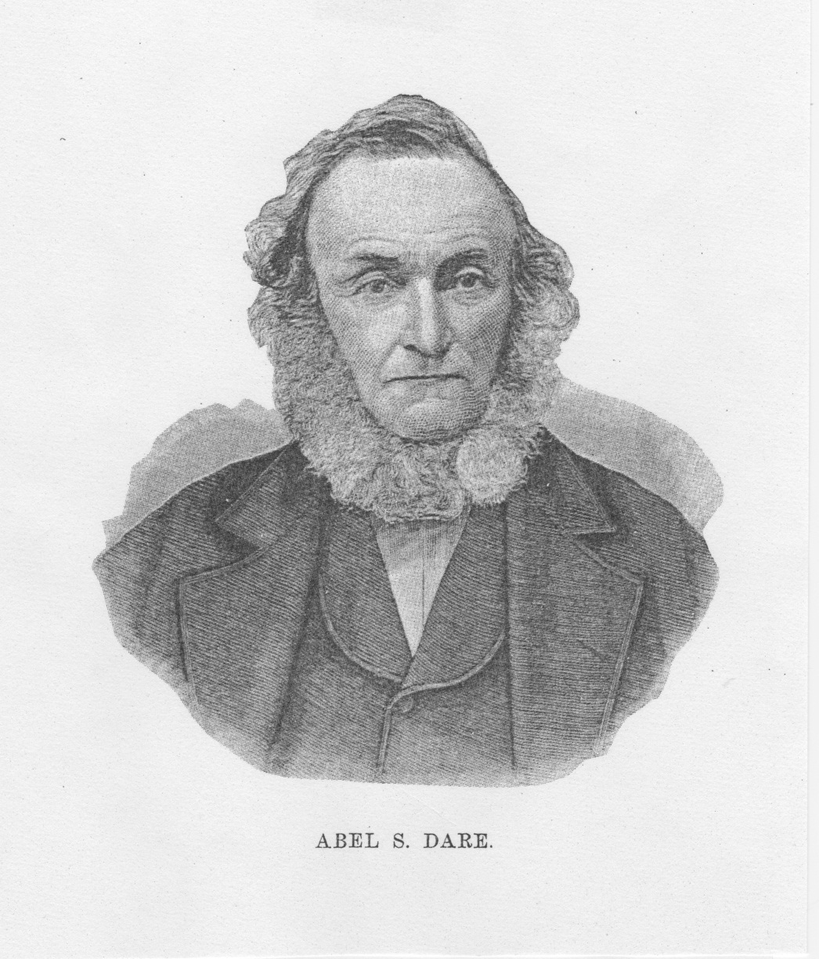
Drawing of Abel Sheppard Dare- b. 1803

Slide 15
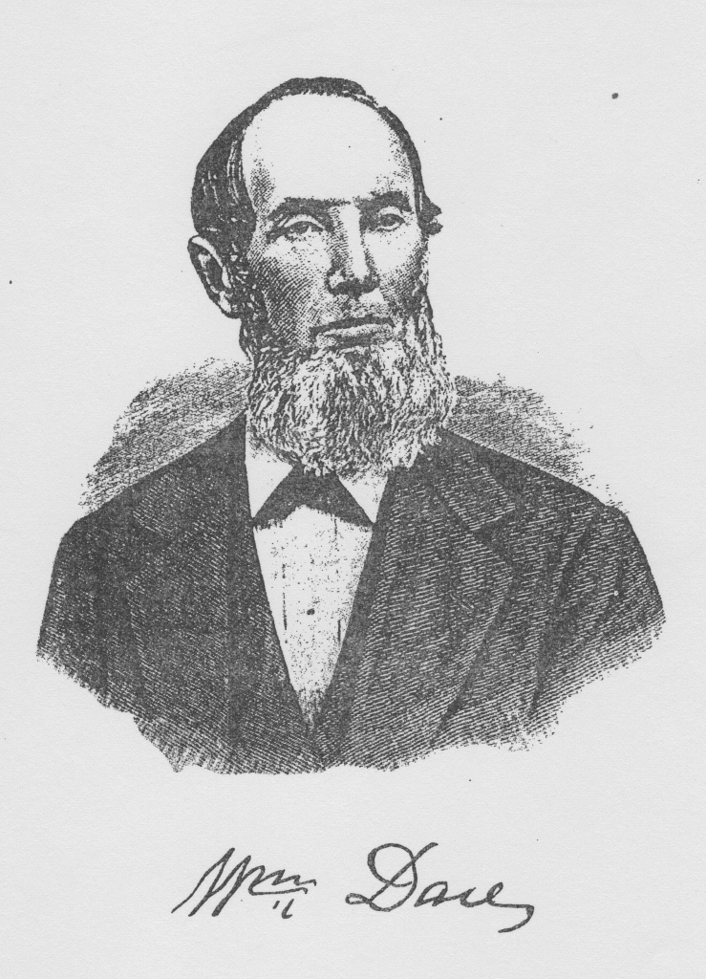
William Dare in the 1800's in S. Jersey

Slide 16
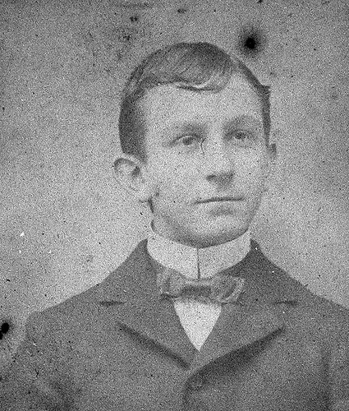
Herbert Dare

Slide 17
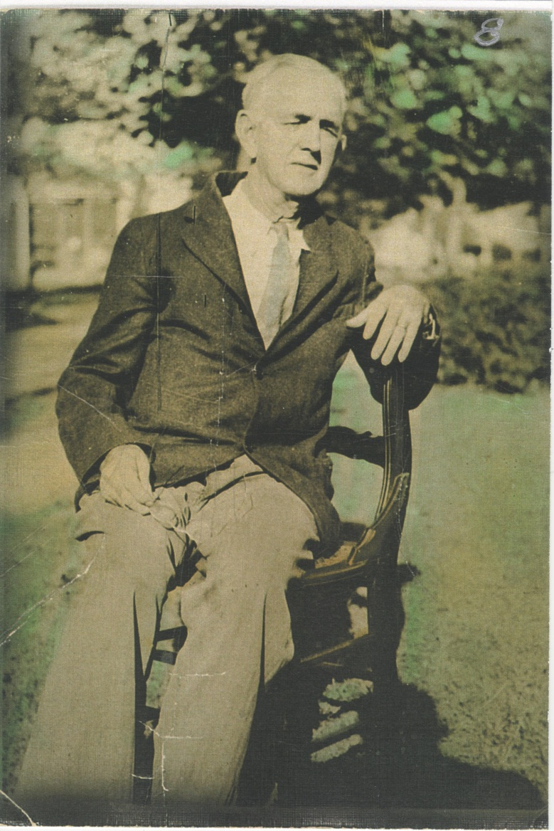
Samuel Clement Dare abt 1933

Slide 18
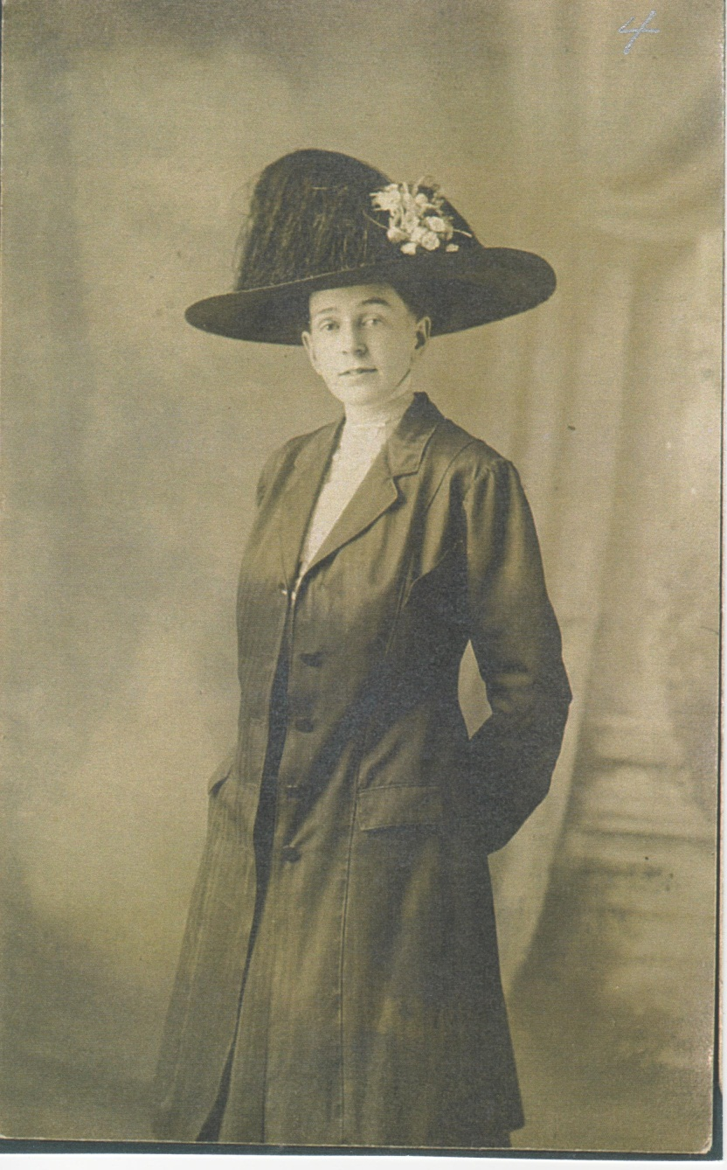
Sadie Dare Barrett - abt 1912

Slide 19
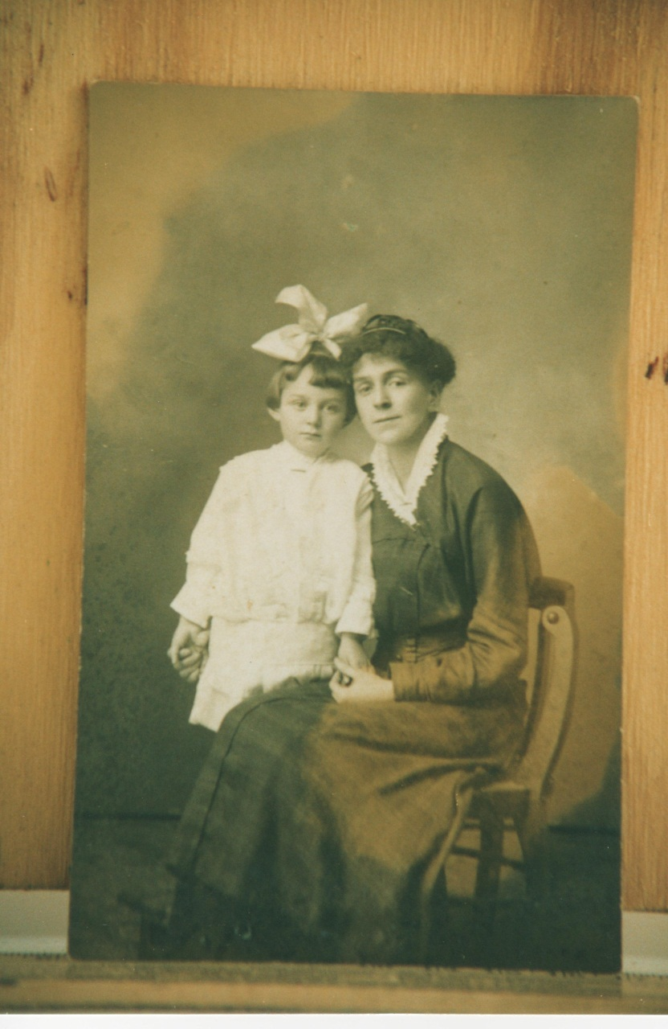
Mildred & Sadie Dare Barrett - 1916

Slide 20
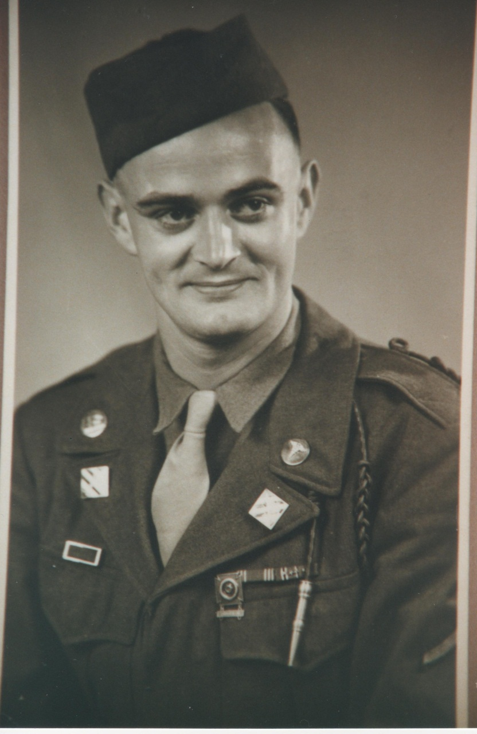
Kenneth Keen Barrett - July 1945

Slide 21
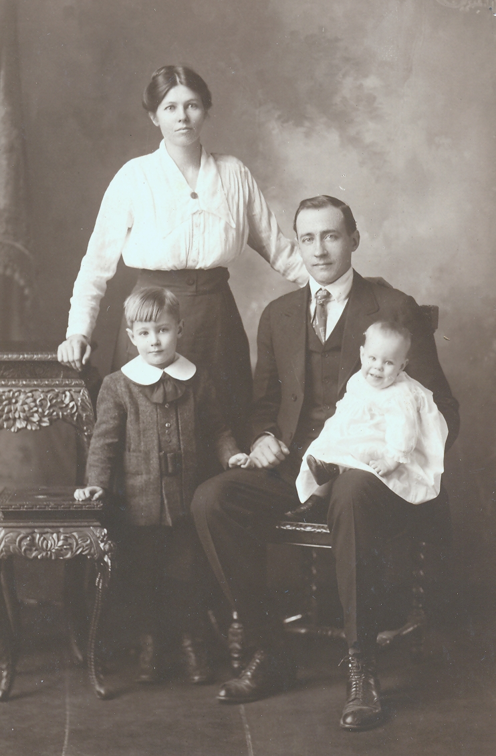
Charles Frederick and Anna Dare with Edwin and Robert - Devon to Illinois Dares

Slide 22
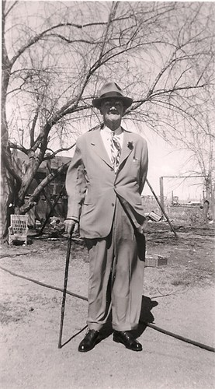
William Alexander Dare b.1863 – KY

Slide 23
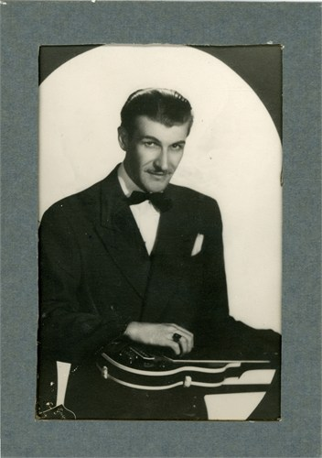
William Alexander Dare b.1809 – KY

Slide 24
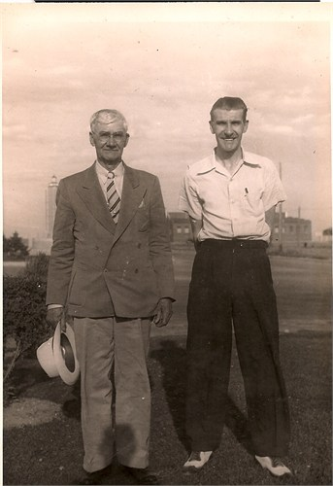
William Alexander Dare Sr and Jr of Kentucky

Slide 25
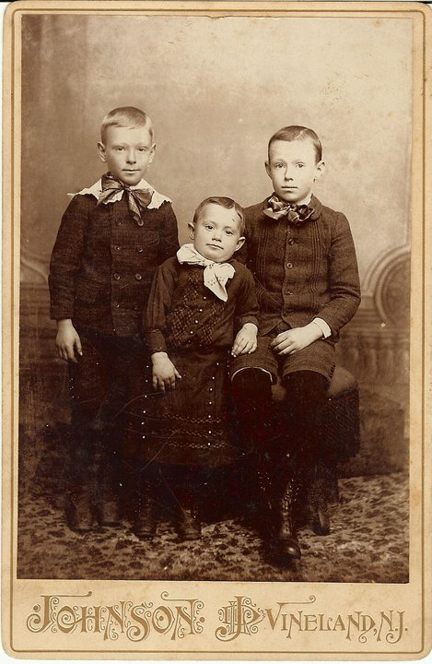
Harry, Albert, and Oscar Dare

Slide 26
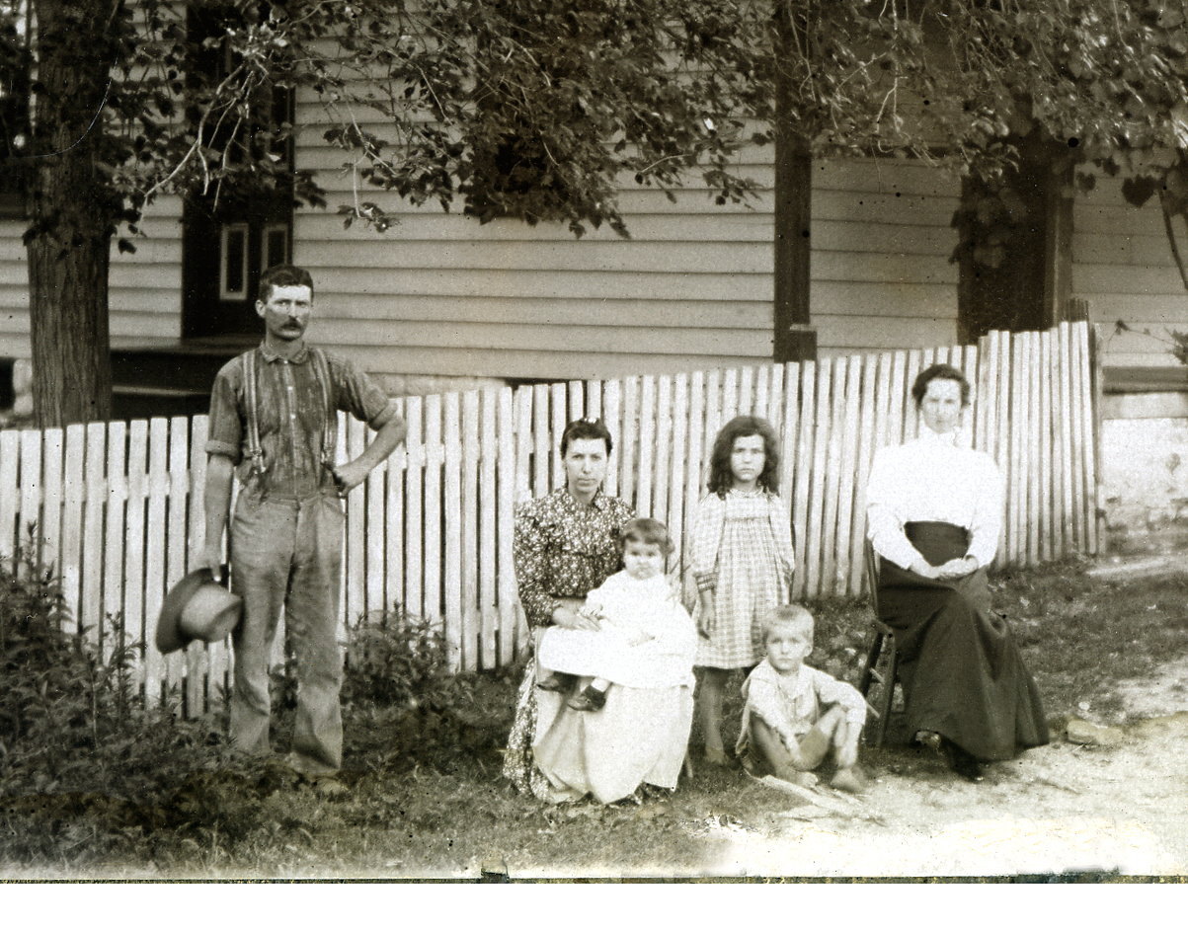
Robinson Family - Horse Branch Farm, Stow Creek, NJ

Slide 27
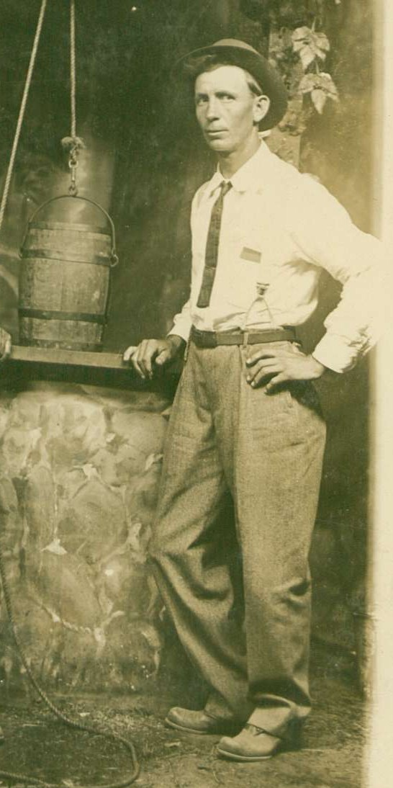
Robert Grant Dare Picture - b 1879 in Iowa

Slide 28
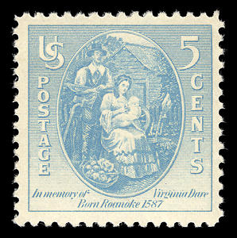
Virginia Dare Commemorative Stamp - 1937

Slide 29
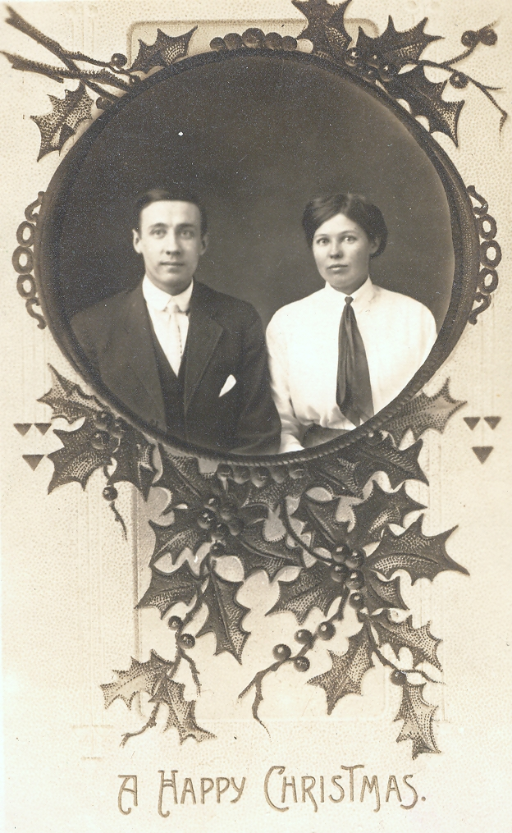
Ernest Frederick Dare in Peoria, IL
Notes:
Ernest Frederick Dare in Peoria, IL

Slide 30
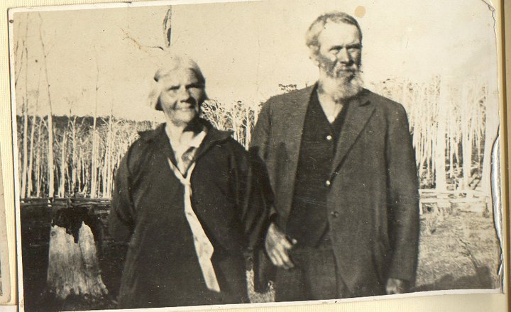
James and Eliza Dare in Tasmania

Slide 31
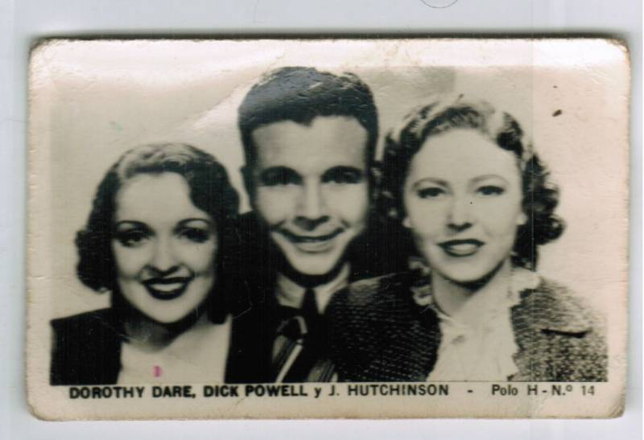
James and Eliza Dare in Tasmania

Slide 32
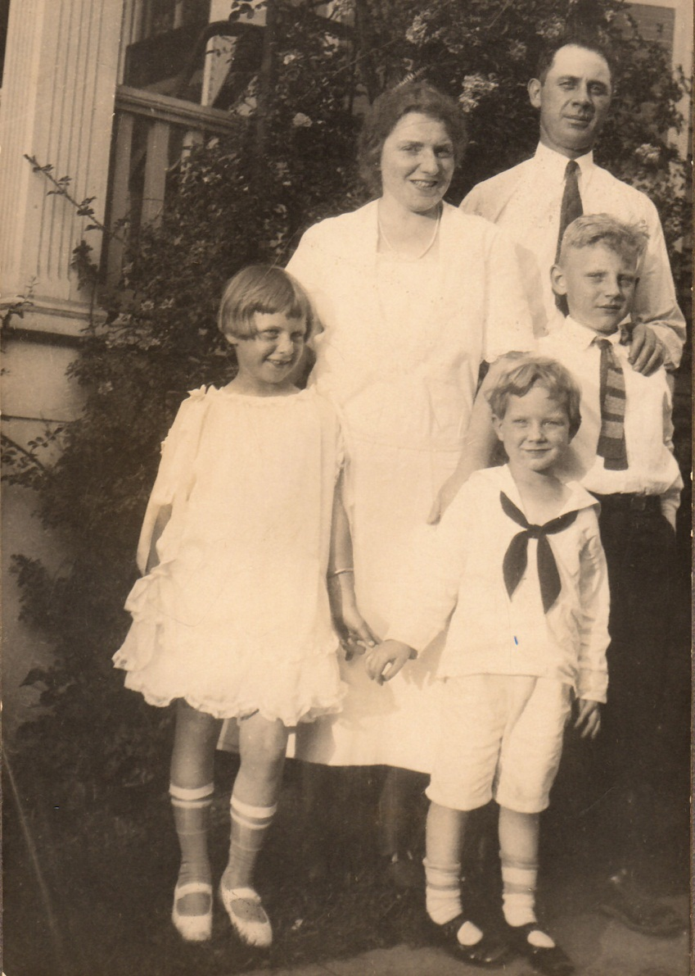
Manning & Helen Dare w Manning Jr., Helen, & Charles from Calvert Co, MD and Boston, MA

Slide 33
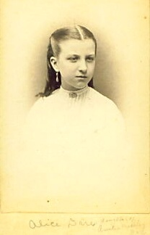
Alice Dare

Slide 34
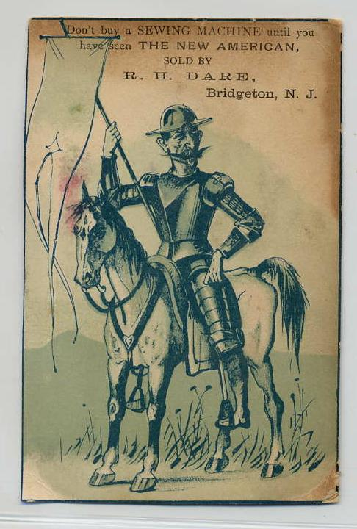
Buy a sewing machine from RH Dare of Bridgeton !

Slide 35
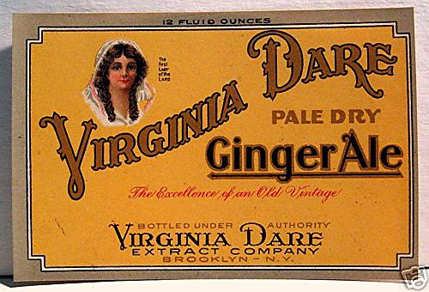
Virginia Dare bottling company in Brooklyn

Slide 36
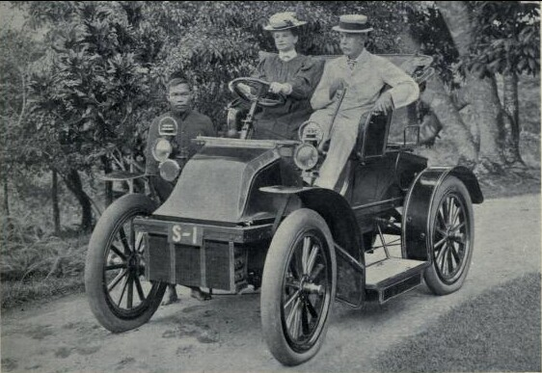
YES, they are descendants of
Captain William Dare of Lyme Regis and NJ !
Mr and Mrs George Mildmay Dare of Singapore

